Slide 1
speedyLoc
Presented by:
Shubhi Mittal, Sandarsh Srivastav, Rongxuan Liu

Slide 2
WHY?
Directly affects application performance.
Independent of threading models.
High throughput with large numbers of threads and processors in a preemptive multitasking environment.
Malloc implementations exist in a wide spectrum. It is interesting to compare them.
A good malloc implementation can reduce the TLB miss rate, the cache miss and the amount of interconnect traffic for an application.

Slide 3
WHAT’S NEW?
Exploiting the similarity in the architecture design of LFMalloc and TCMalloc.
Fine grained size classes for small sized memory requests.
Balance between number of size classes and fragmentation.
Mostly Lock free approach to memory allocation to increase parallelism.
Reduces the chances of a deadlock.
Upcalls are implemented using signal handler in MP-RCS.
COMBINED IDEAS FROM TCMALLOC & LFMALLOC

Slide 4
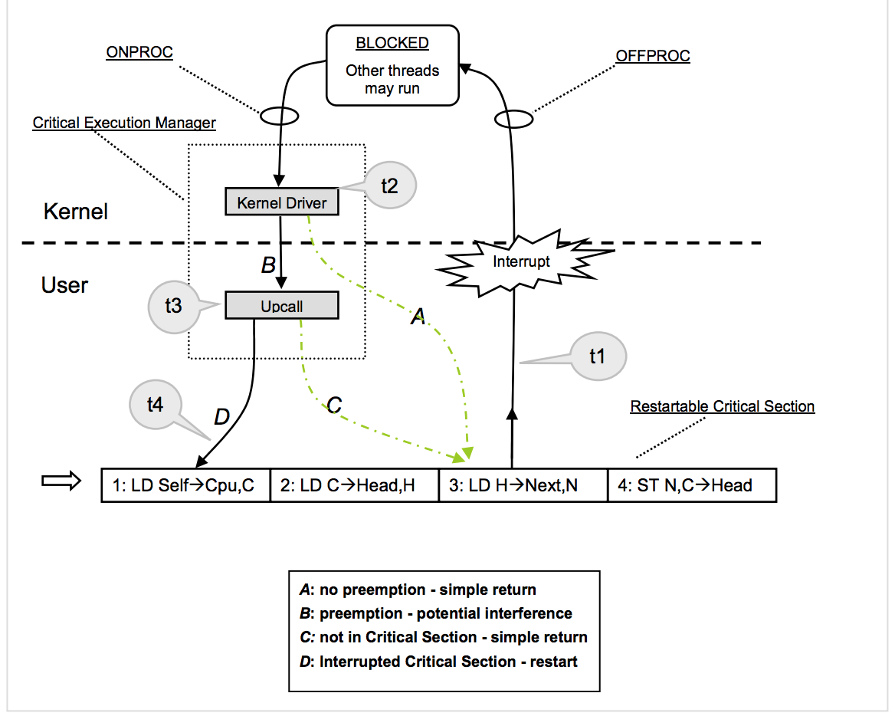
HOW?
Memory Allocator
MP-RCS

Slide 5
KERNEL DRIVER
Role of Kernel Driver
Check for our own process and deliver upcalls.
The upcall is sent to the notification routine which would then take a decision whether to restart the critical section or not.
The kernel driver does nothing if there was no preemption
The notification routine does nothing if the thread was not in the critical section.

Slide 6
KERNEL DRIVER
Design and Implementation details
Workaround for Solaris ONPROC and OFFPROC.
Kprobes implemented in a Loadable Kernel Module to probe for the “switch_to” kernel call and a signal handler to interrupt the thread issued from the kernel module.
Challenges
Kernel crashes
Difficult to debug

Slide 7
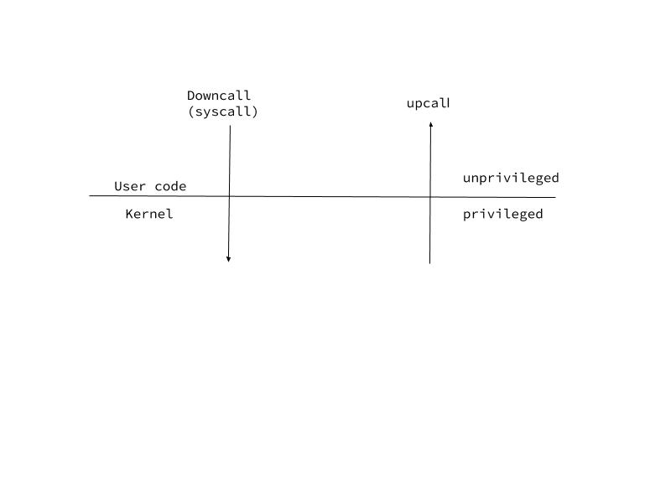
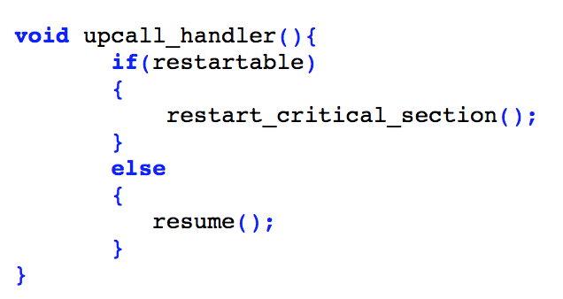
UPCALL
Implemented via IPC between Kernel space and user space.
Strategies tried for IPC and changing process flow.
RAM based FS - debugfs
Change Instruction Pointer (IP)
Send a signal

Slide 8
RCS (simple version)
Malloc
Pop head from local free list
Free
Push head to local free list
null
Notes:
RCS stands for restartable critical section that commits a change to the local free list;
Essentially, RCS pops head off, or pushes a node to the local free list in a lock free fashion;
If a thread gets interrupted during an RCS, it retries the commit;
To understand what exactly is local free list, let’s take a quick detour to the design of speedyloc;

Slide 9
ALLOCATOR DESIGN
One local HEAP for a CPU core
HEAP 1
CPU 1
Size Class 1
Size Class 2
One Super Block per Size Class for a local HEAP
Super Block 1
Super Block 2
Local Free List
Remote Free List
Local Free List
Remote Free List
Local Free List: blocks that were freed/allocated by CPU 1
Remote Free List: blocks that were freed by other CPUs
A block can only be freed on the super block that created it
Notes:
Speedyloc maintains a local HEAP for each CPU core;
A local HEAP has a number of superblocks, each of them corresponds to a specific size class; (say size 16 bytes and 32 bytes)
Each super block has two free lists -- local and remote; (the names are misleading)
In fact I’d rather call them fast-path free list, and slow-path free list, we will see the detail in a minute;
But for now, the important thing we should understand is that a block cannot be exchanged between superblocks, it can only be freed and allocated by the superblock that “gave birth” to it. Simply put it either belong to the mather superblock (local or remote), or the user application that called malloc;
Now, one superblock per size class is definitely not enough, (next)

Slide 10
ALLOCATOR DESIGN
Global HEAP
Shared Resource
Size Class 1
Size Class 2
Limitless Super Blocks…
(With threshold!)
Super Block 1
Super Block 2
Next
Next
Super Block 3
Super Block 4
Global Heap maintains two types of Super Blocks:
New Super Blocks
Super Blocks swapped by local HEAPs
Notes:
So we have a shared pool of resources called the Global HEAP;
A global heap is allowed to create new super blocks whenever there’s a shortage of memory;
But once the completely unused superblocks reaches a certain threshold, it will destroy unused superblocks;
Also, due to the limitation that blocks cannot be exchanged between superblocks, we allow superblock to be exchanged between global heap and local heaps -- basically to minimise the communication to the shared HEAP; (instead of do it for 1, do it for many)
With these in mind, now let’s have a look at malloc logic;

Slide 11
MALLOC ALGORITHM
Try Again
If no
If no blocks found
Compute Size Class
Is It Big ?
RCS
Ask Global Heap
Pre-indexed
Yes ? Congratulations
Pop the head off
Swap Super Block
Find the size class using a pre-index array
Construct a super block and return immediately
If a local free block is found, pop it off and return immediately;
Retry if preempted
Find (or create) a super block in Global Heap, swap it with the current (local) super block, goto RCS
Fast Path
Notes:
The sections colored in blue is the fast path for malloc, where it tries to find free blocks from local HEAP;
The flow path tries to swap a local superblock (full) with a global superblock;
Two important facts about this process:
RCS, as previously mentioned, will keep recommit the change until it does not get interrupted by the other threads;
The slow path always goes back to fast-path, in order to keep the allocation process in the local HEAP;

Slide 12
FREE ALGORITHM
If no
If super block is not local
Is It Big ?
Find Mama
RCS
Push to Remote
Yes? Destroy
Locate the Super Block
Push it to head
The only Lock !
Destroy the big block and return immediately
Find the super block that “gave birth” to this memory block
Add the block to the local free list of the super block of the local HEAP;
Jump out of RCS if the super block does not belong to the HEAP of the current CPU core
Lock the remote super block (it now belongs to a different CPU), and push it to the remote free list
Fast Path
Notes:
Free shares the same logic as malloc;
The fast-path tries to push block to local free list;
The slow-path tries to push block to remote free list;
Slow-path only takes place when, say, the thread changes from CPU1 to CPU2, and the previously allocated memory does not belong to local HEAP of CPU 2.
In this case, free has to establish a communication between two resources that works independently, this is where the only block comes in to ensure no contention happens.

Slide 13
RCS (with details)
Malloc
Determine current CPU
Find superblock of that CPU
Find free block, pop
Free
Determine current CPU
Check locality of mother superblock
(if local) push block
(if remote) go to slow path
null
Notes:
So, the details of the two RCSs looks like this. We always determine the current CPU from within the RCS, to avoid

Slide 14
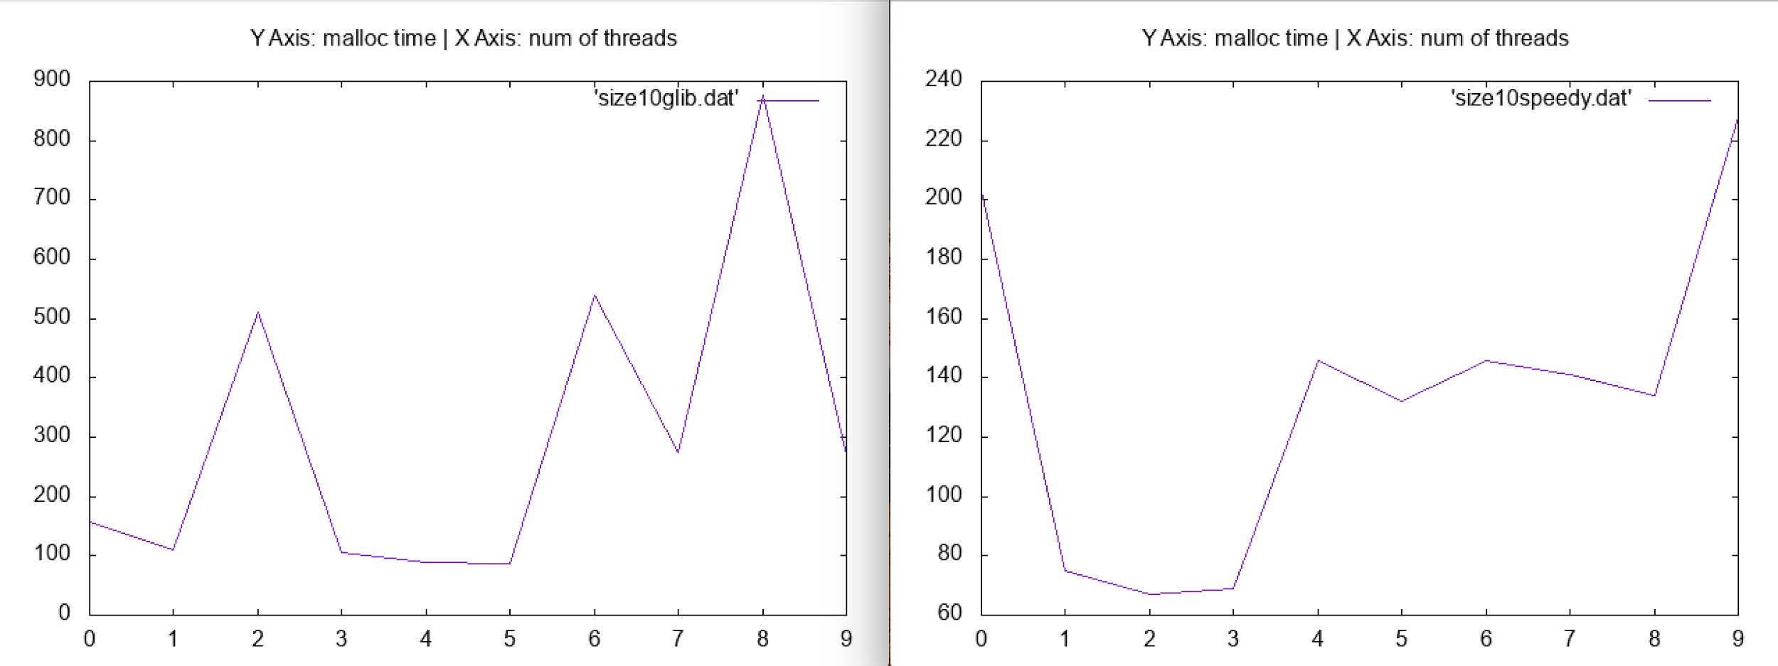
10 Threads
Glibc
SpeedyLoc

Slide 15
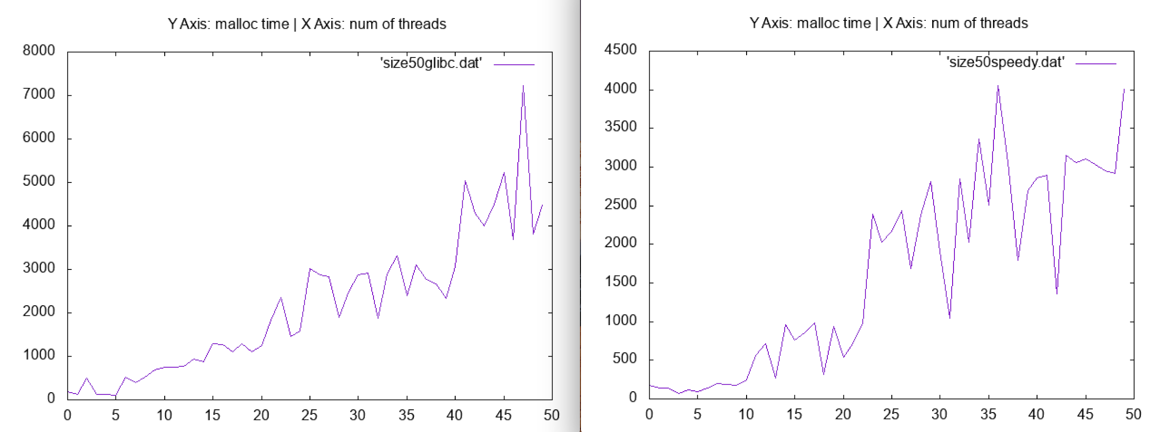
50 Threads
Glibc
SpeedyLoc

Slide 16
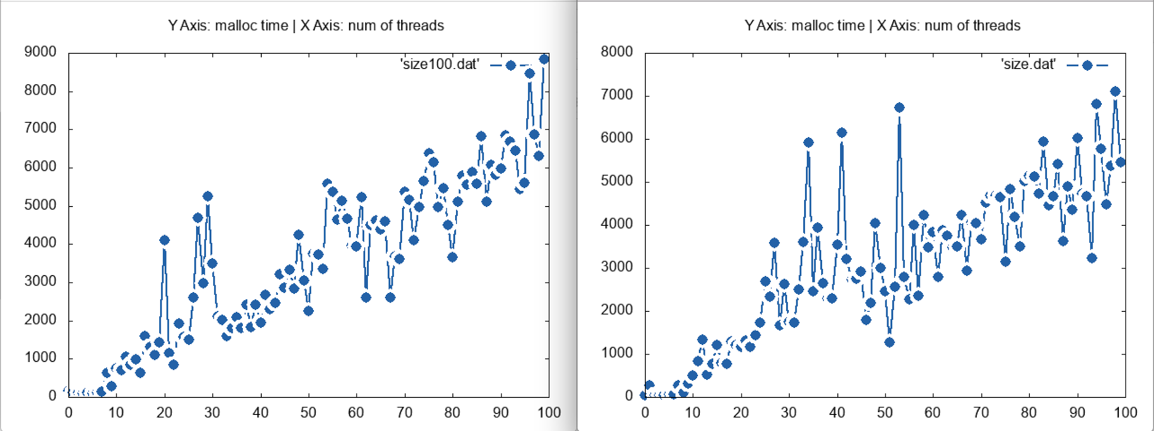
100 Threads
Glibc
SpeedyLoc

Slide 17
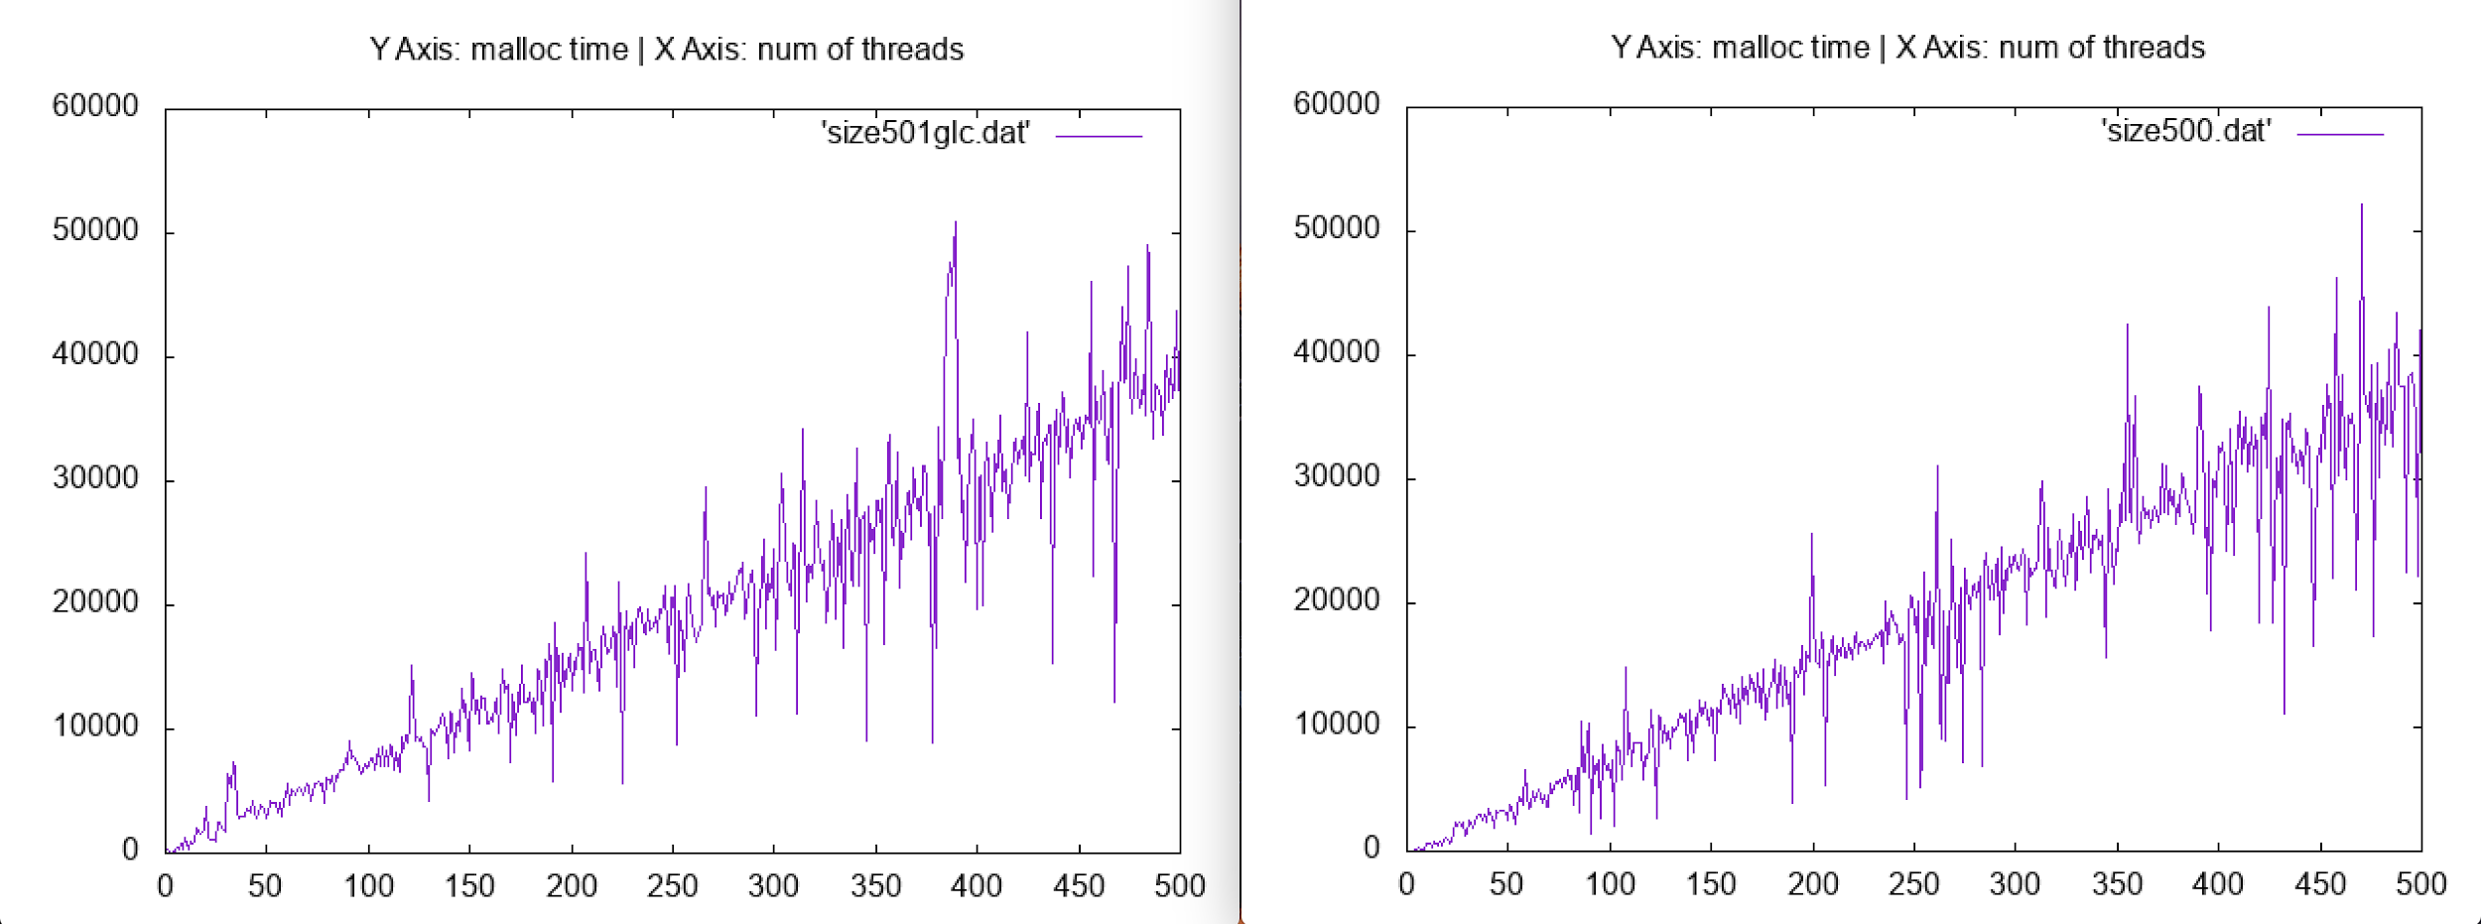
500 Threads!!
Glibc
SpeedyLoc

Slide 18
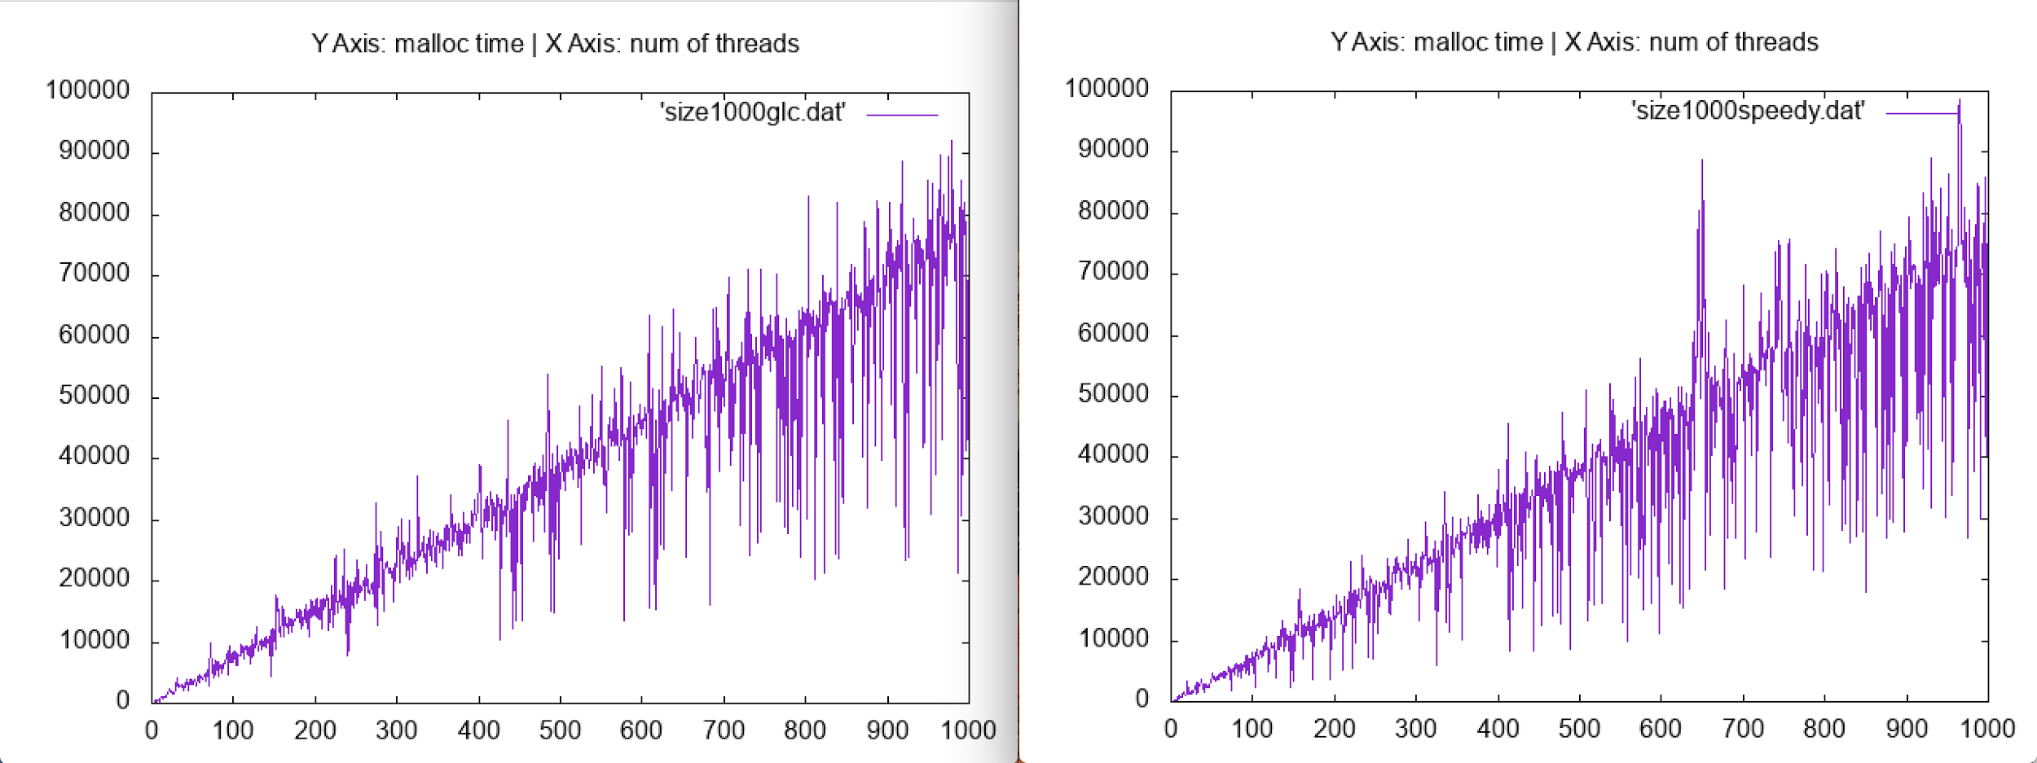
1000 Threads!!!
Glibc
SpeedyLoc

Slide 19
FUTURE WORK
Issues
High frequency of upcalls.
Kernel driver does not support re-routing upcalls based on specific threads.
Process can go into a cycle of upcall->kernel->upcall as the number of threads increases.
Proposed Solution
Keeping a data structure that maps a thread in user space with a specific core each time kernel driver receives the its own thread transitioning from runnable to running.
Public Repository: https://github.com/shubhiM/speedyLoc

Slide 20
REFERENCES
Dice, David & Garthwaite, Alex. (2002). Mostly lock-free malloc​. SIGPLAN Notices. 38. 269-280.
http://goog-perftools.sourceforge.net/doc/tcmalloc.html
http://wiki.tldp.org/static/kernel_user_space_howto.html
http://freesoftwaremagazine.com/articles/drivers_linux/

